Slide 1
Bank Marketing Analysis
Group 213
VAISHALI PACHISIYA a20411068
NUPUR SINGH A20431624
SOMENDRA CHAUDHARY A20432563

Slide 2
Bank Marketing Analysis
This project is based on the direct marketing campaigns of a Portuguese banking institution. This marketing campaigns were based on phone calls. Often, a client was contacted more than once in order to assess if the product (bank term deposit) would be subscribed ('yes') or not subscribed (‘no’).

Slide 3
Implemented multiple classification algorithms to build a model that predicts the success of telemarketing calls for selling bank long term deposits.
Potential Solutions
We will be making different models and test for their accuracy to decide which model provides the best solution to improve the revenue by opening deposit accounts in the bank.
Problem Statement

Slide 4
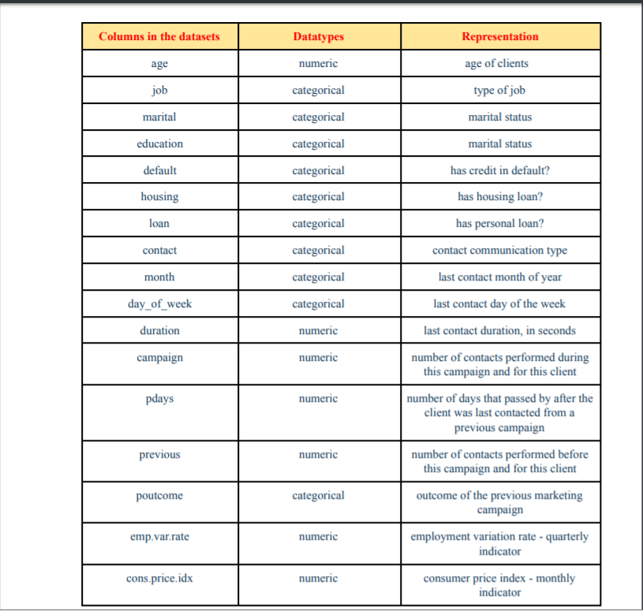
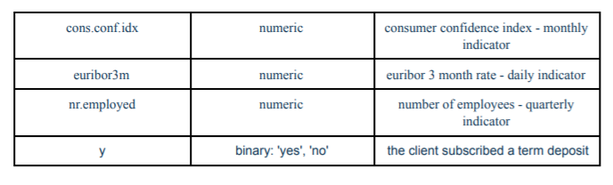
Data Analysis:

Slide 5
DATA VISUALIZATION USING BOX PLOTS
AND HISTOGRAMS

Slide 6
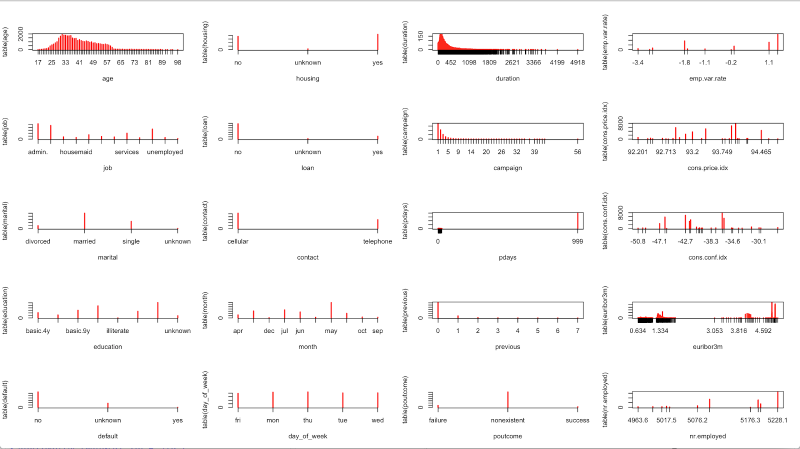

Slide 7
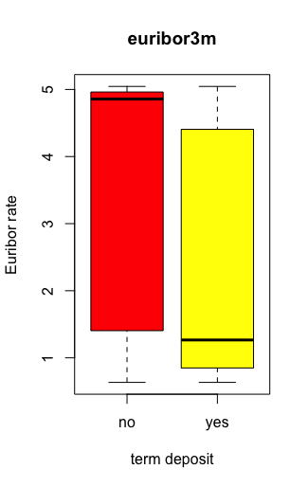
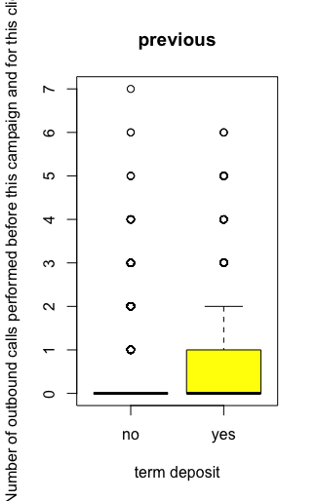
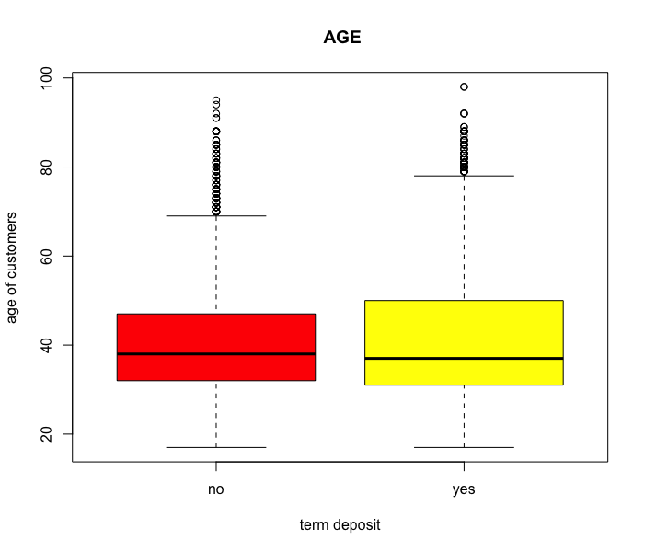
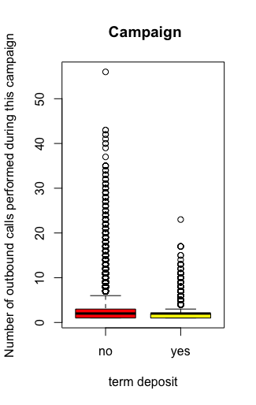
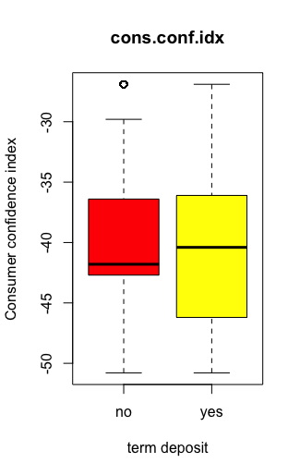
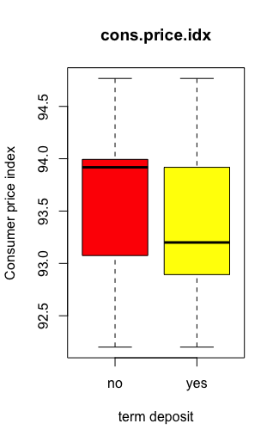
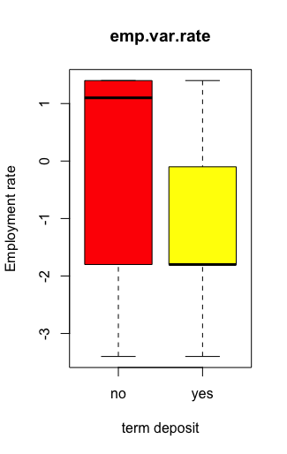
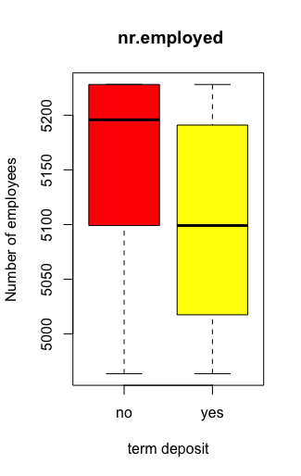

Slide 8
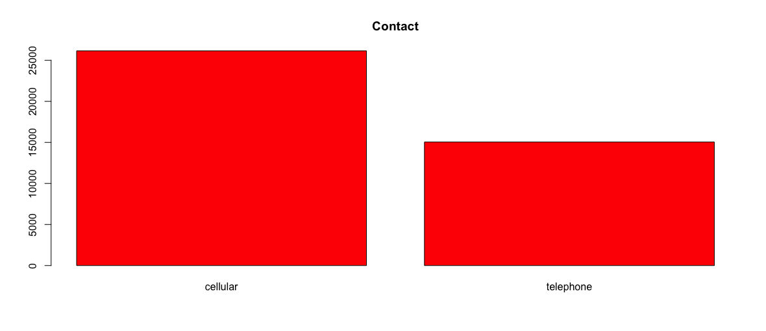
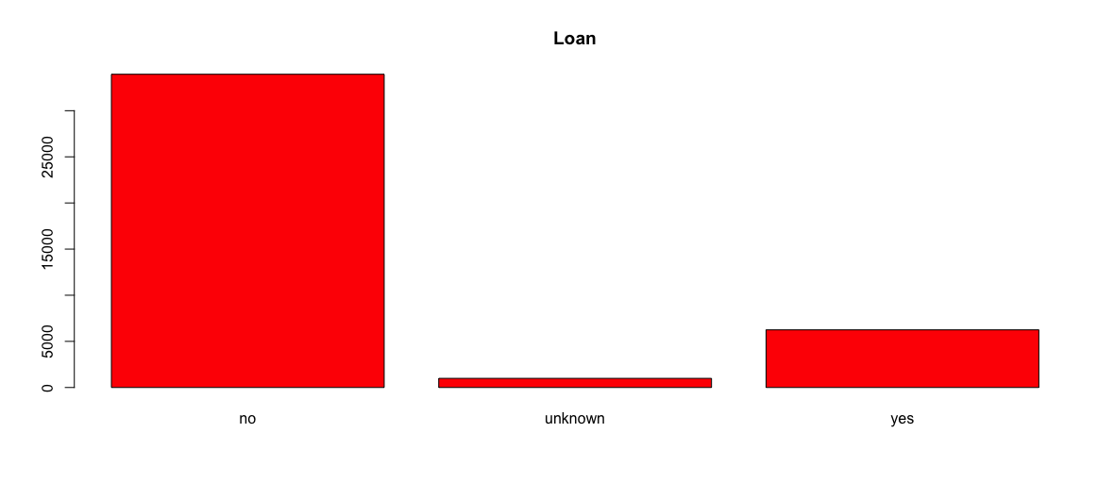
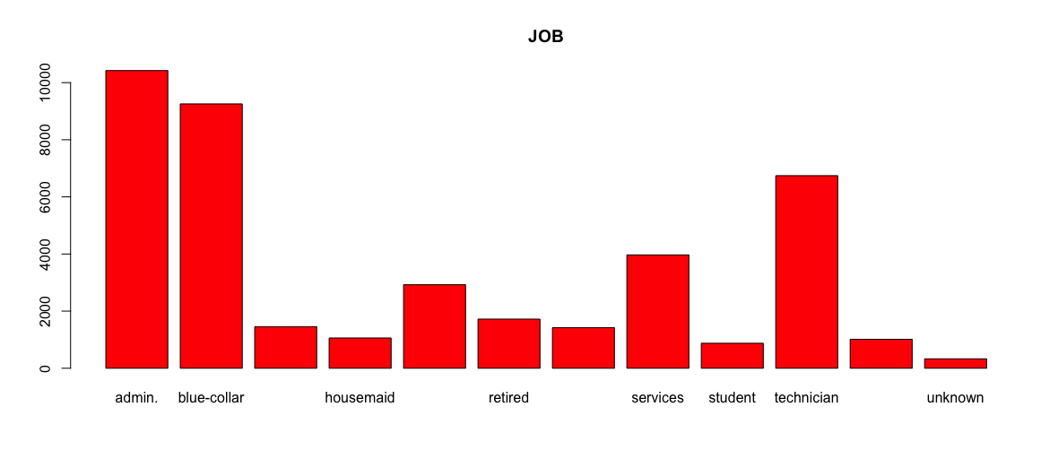
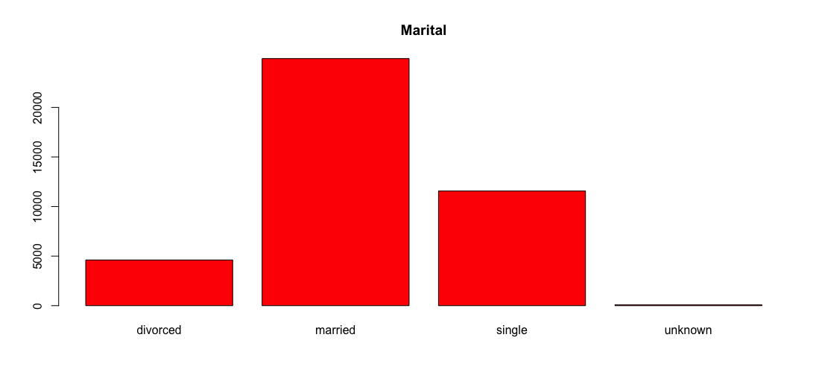
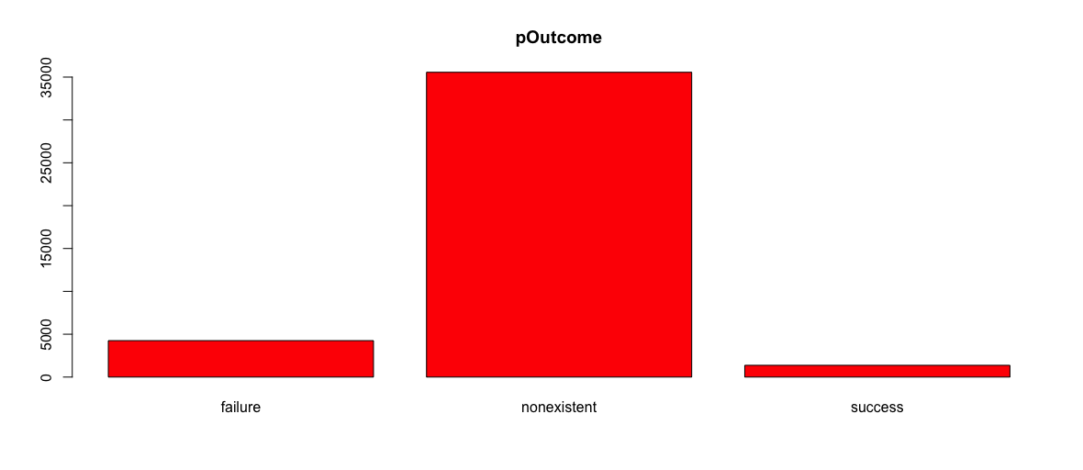
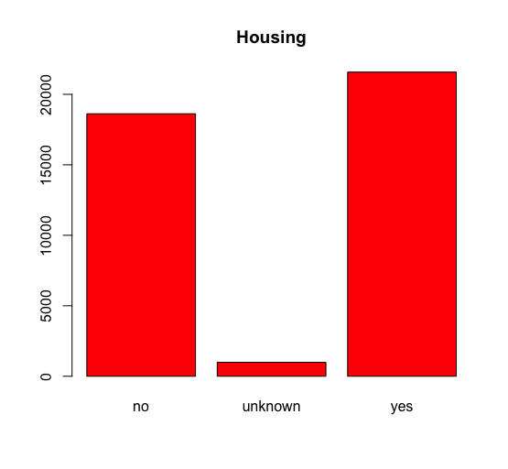
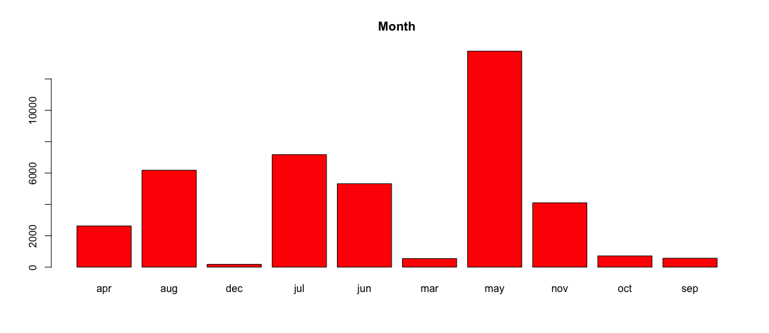
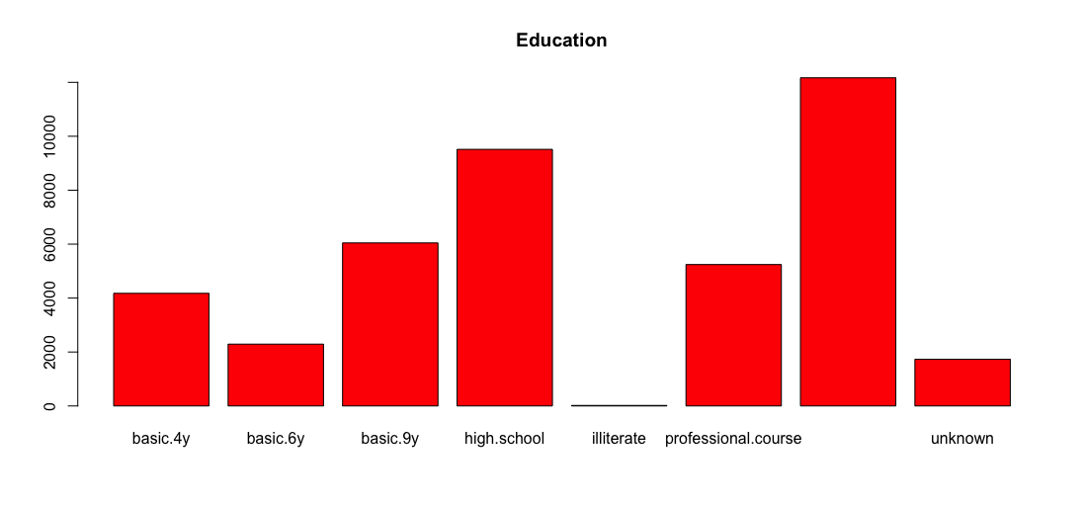
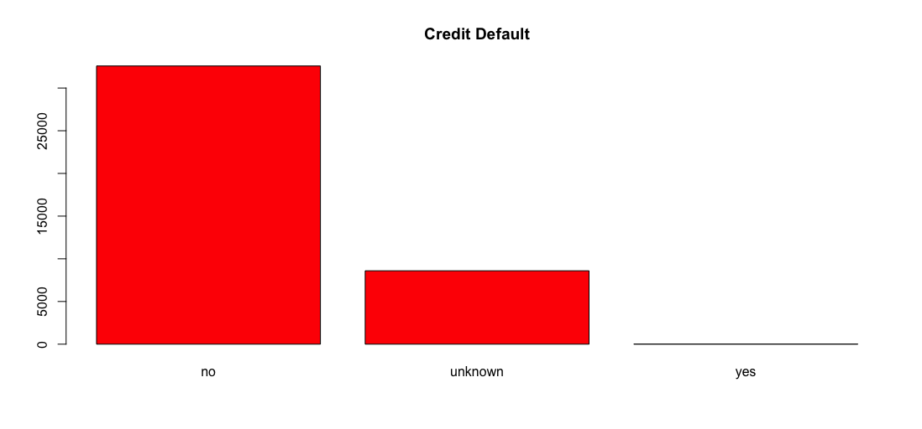

Slide 9
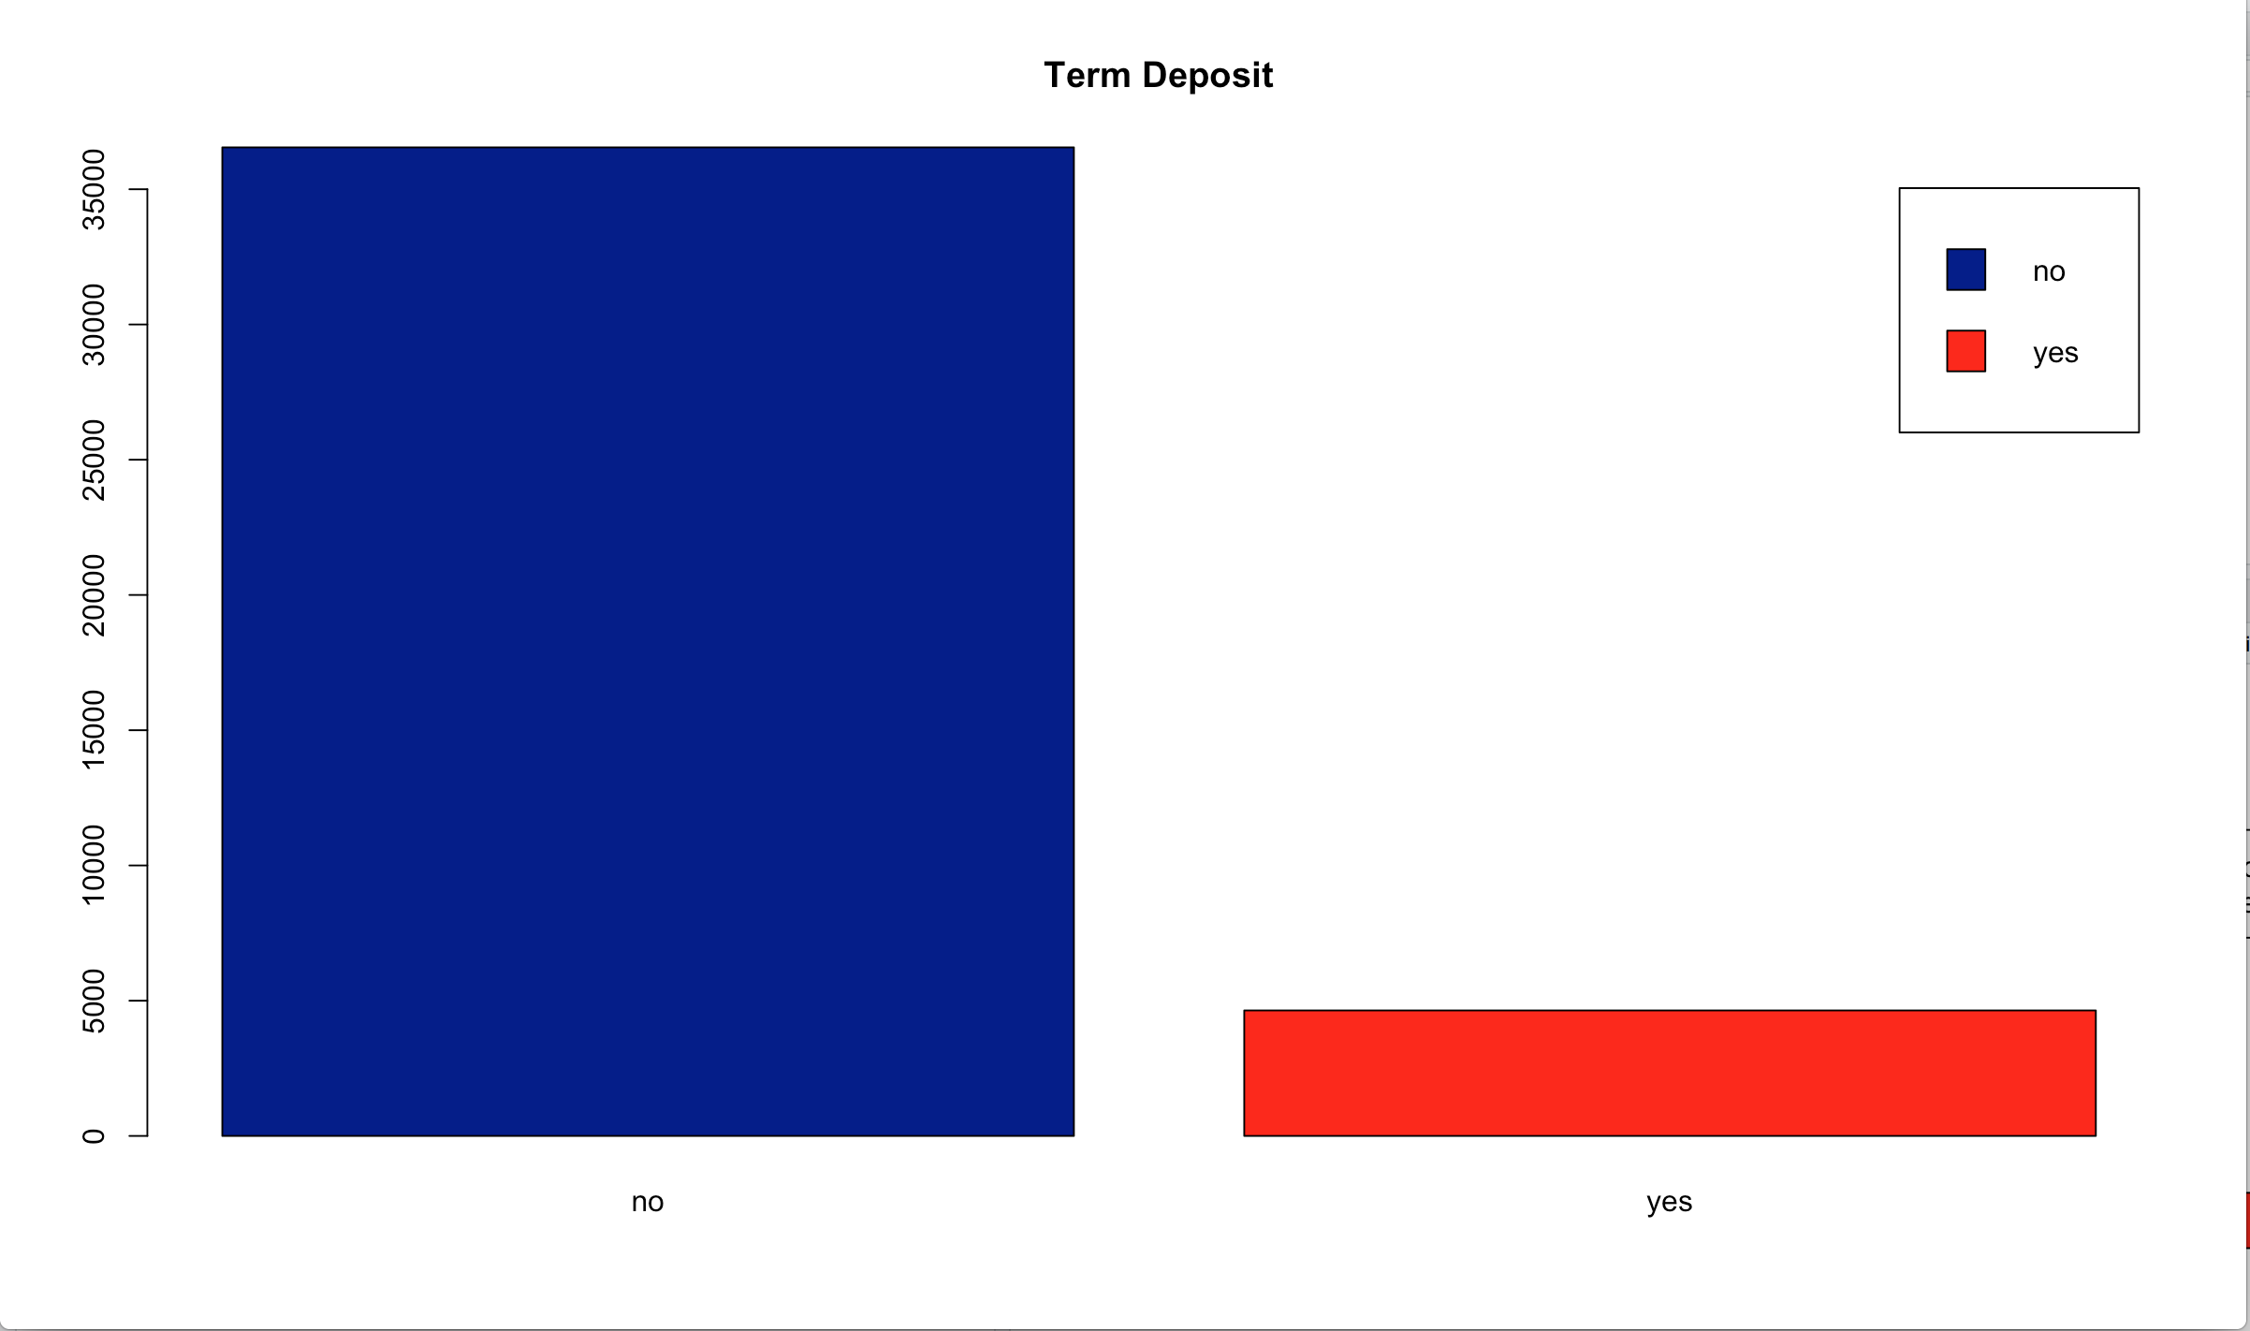
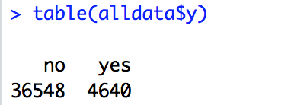
DATA BALANCING
Label Term Deposit is heavily biased
To resolve, we used upSample() in the caret package for Upsampling

Slide 10
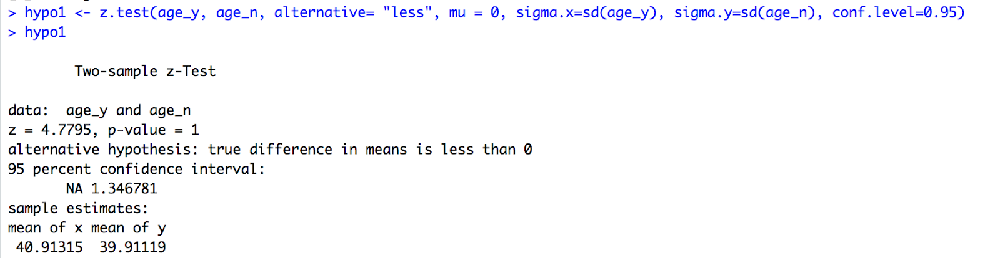
Hypothesis Testing
Null Hypothesis : Average age of people saying yes to term deposit is greater than people saying no
Alternative Hypothesis: Average age of people saying yes is less than the average age of people saying no to term deposit.
Two sample One-tailed Hypothesis Testing

Slide 11
Classification Models:
Logistic Regression
K Nearest Neighbor
Naïve Bayes’

Slide 12
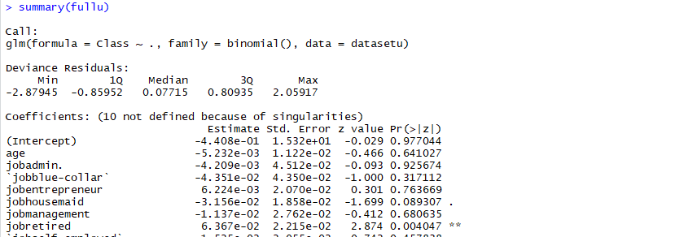
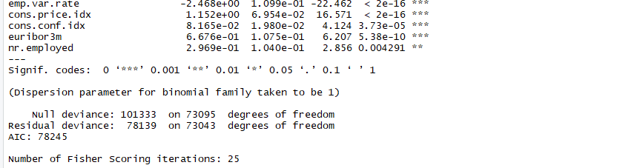
Logistic Regression Full
AIC = 78245

Slide 13
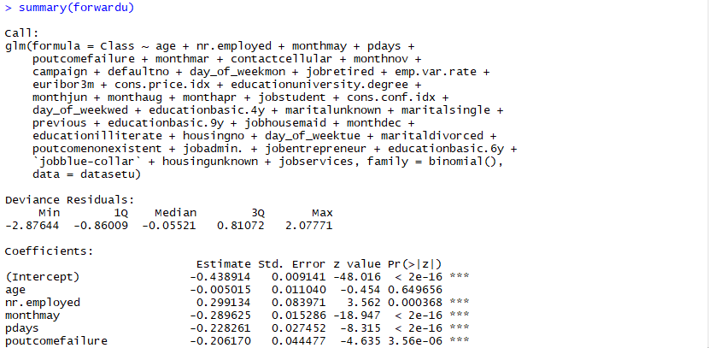
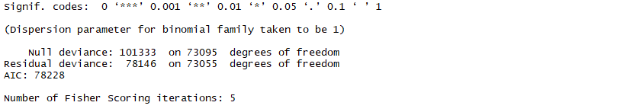
Logistic Regression Stepwise Forward
AIC = 78228

Slide 14
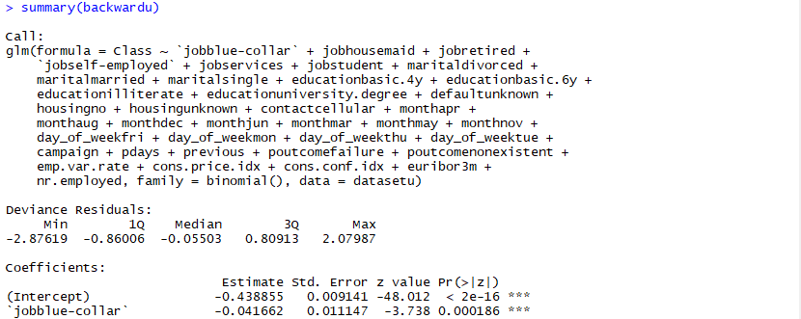
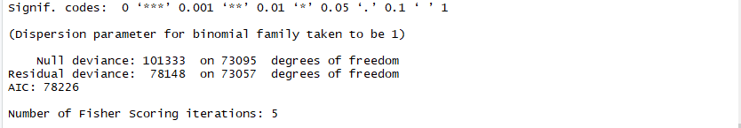
Logistic Regression Stepwise Backward
AIC = 78226

Slide 15
Logistic Regression Comparison on AIC
Model | AIC
Logistic Full | 78245
Logistic Stepwise Forward | 78228
Logistic Stepwise Backward | 78226
AIC values are close, so we cannot be sure which model is best, so we proceed with cross validation.

Slide 16
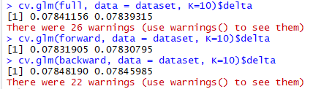
Logistic Regression Cross-validation
Accuracy = 1- error rate
Model | Accuracy
Logistic Full | 82.12304%
Logistic Stepwise Forward | 82.12915%
Logistic Stepwise Backward | 82.12983%

Slide 17
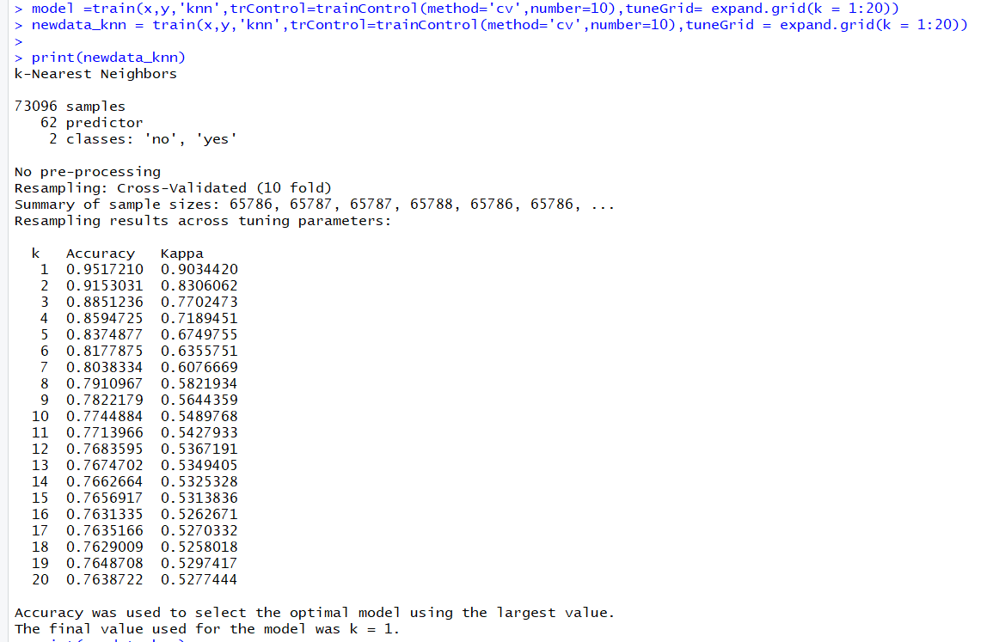
KNN Model
Best accuracy at K=1 (95.17%)

Slide 18
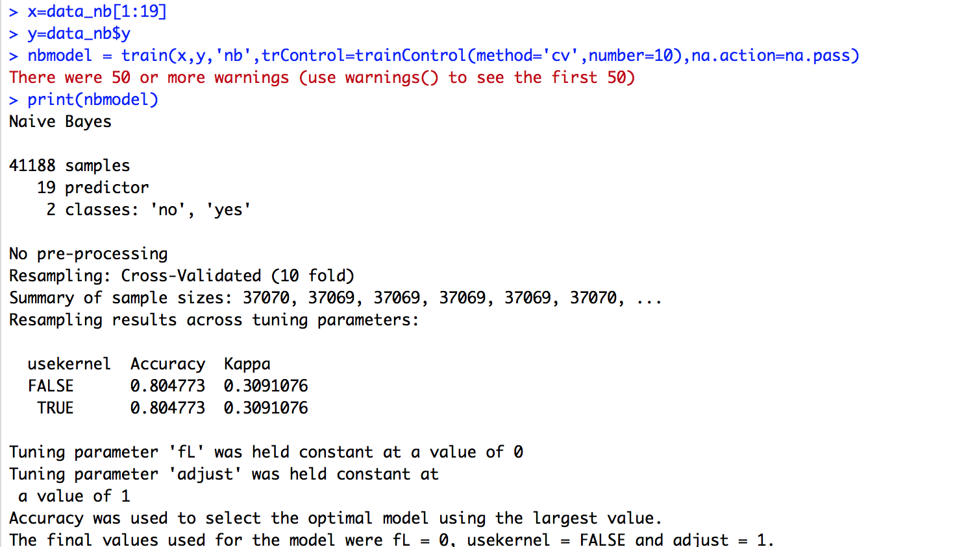
NAÏVE BAYES Model
Accuracy = 80.47%

Slide 19
Future Work:
Decision Tree
Random Forest
Combination of models
Neural Networks

Slide 20
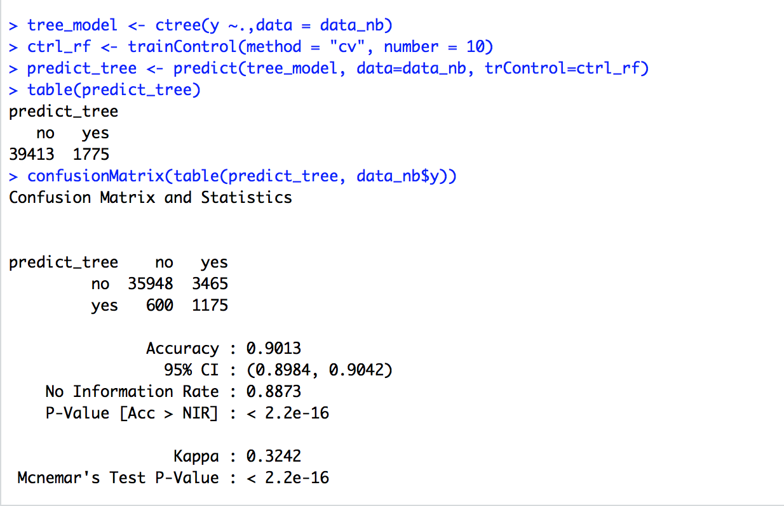
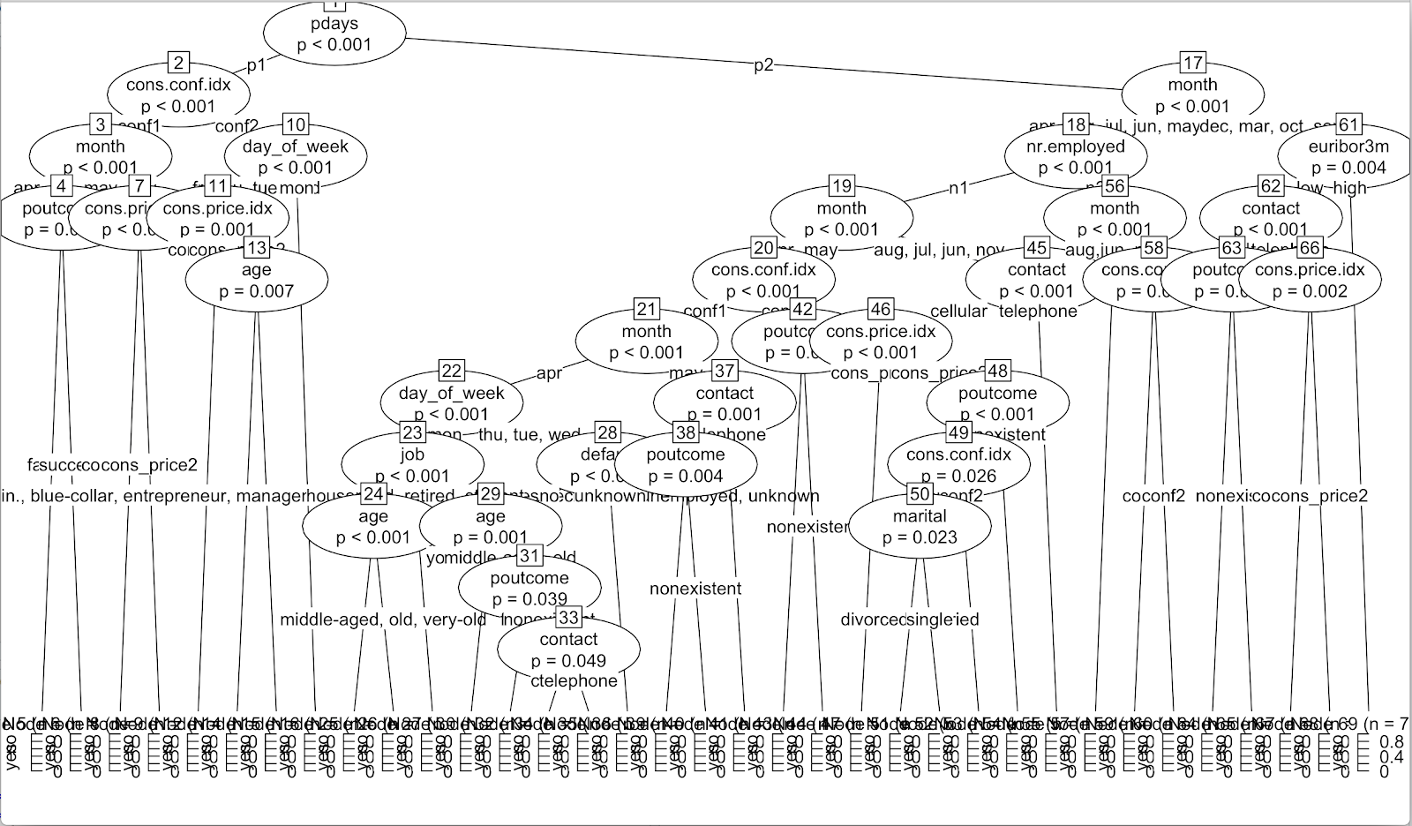
Decision Tree
The decision tree gives an accuracy of 90.13%.

Slide 21
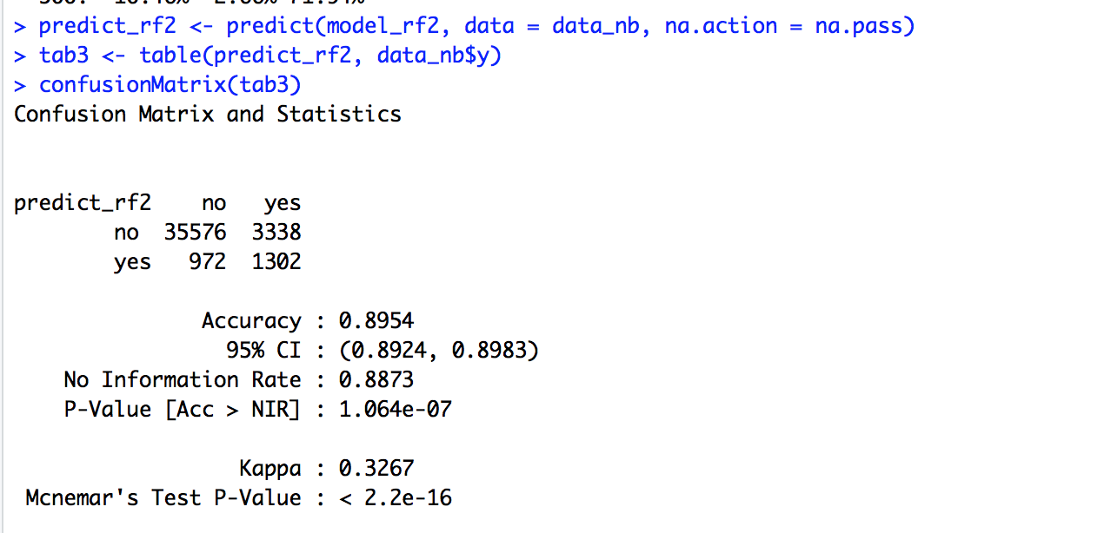
Random Forest
The Random Forest gives an accuracy of 89.54%.

Slide 22
COMPARISON
Model | Accuracy
KNN | 95.17%
Naive Bayes | 80.47%
Logistic Full | 82.12304%
Logistic Stepwise Forward | 82.12915%
Logistic Stepwise Backward | 82.12983%
Decision Tree | 90.13%
Random Forest | 89.54%

Slide 23
CONCLUSION
Analytics algorithms can help us in correctly classifying whether someone will open a deposit account with the bank or not.
For this purpose, the best model/ algorithm is KNN as it can correctly classify 95% records.
Hence, bank telemarketers can now determine if a potential customer will open a deposit account or not with 95% accuracy, helping them to target customers more accurately, saving time and man hours.

Slide 24


